Slide 1
RESTORATION PANEL SUMMER Meeting 2026

Slide 2
AGENDA
IWA Restoration Panel Agenda 22nd August 2026, Droitwich Spa Community Hall, WR9 8RF, 10:30-14:30 | By whom
Welcome, introduction to Restoration Panel and to its Chair: Andy Keane | Mike Wills
Purpose of Meeting | George Rogers, Andy Keane
Background research - what IWA currently think restoration groups' chief needs and concerns are. | Andy Keane
Coffee Break
Talk by the Wilts & Berks Canal Trust - the White Horse Reservoir | Martin Holliss
Talk on the Stafford Riverway Link | Geoff Dobbs
Offers by groups to give future short presentations | all
Break for lunch
The Northern Canals Association meetings | Andy Keane plus all delegates
How can IWA support restoration groups with Construction (Design and Management) compliance? | George Rogers plus all delegates
Suggestions for future "topics of interest" discussions | all
Brief review of day, date and possible location of next meeting | Andy Keane plus all delegates
AOB (inc. dealing with the new CRT Restoration Engineer and the RDP processes) | All (John Dodwell)

Slide 3
HOUSEKEEPING
Emergency Exits
Accessible Toilets
No smoking or vaping in the venue
Fire Alarm
Attendee Contributions

Slide 4
Welcome & Introduction to the IWA Restoration Panel
Mike Wills
National Chair

Slide 5
THE IWA WANTS TO CONNECT
Restoration has been at the very heart of IWA since its foundation.
Perhaps we lost our way a little, in recent years.
There is now a new commitment, fresh structures and the funds to appoint a Waterways Restoration Officer.
This Restoration Panel is part of our changed approach.
Welcome Andy Keane as its Chair.

Slide 6
Purpose of meeting
George Rogers (RDG Chair), Andy Keane (RP Chair)

Slide 7
IWA restoration panel
The RP will be a conduit for communications between restoration groups and IWA.
The RP will aim to foster further communications between restoration groups.
The RP will organise a series of online, topic specific sessions to address items of interest to restoration groups.
IWA wants the RP to be complementary and contributory to other networking and knowledge sharing forums, including NCA and the annual IWA/CRT Restoration Conference. Face-to-face meetings will be coordinated to interleave with these other forums.

Slide 8
Background research - what IWA currently think restoration groups' chief needs and concerns are.
Andy Keane

Slide 9
IWA Restoration Hub Central Services Support Improvement– 2022-24.

Slide 10
IWA Restoration Hub Central Services Support Improvement– 2022-24
In early 2022 a study by George Rogers, Chris Madge and Terry Cavender was begun to assess how IWA can best ensure that restoration society needs are met, by providing resources directly or signposting to expertise, and in particular
• the type of skills required;
• the volume of skills required; and
• how such assistance could be funded and delivered.
The team contacted 15 restoration trusts thought to be representative of geography, complexity, size and achievement to date.

Slide 11
CRITICAL NEEDS
The study identified a number of areas as being critical to the success of restorations:
• Environmental Surveys, Ecology and Health and Safety were judged as “critical” more than any other response.
• Biodiversity Net Gain, Hydrology, Engineering Design, Membership Development and Fundraising were reported as “critical” by at least 4 of 9 Trusts.
• Other “critical” areas identified by more than one Trust were Project Management, Green Book knowledge and EA and Water Authority networking.

Slide 12
OTHER NEEDS
Other areas ranked as “important” rather than critical were :
• Technical services like Insurance, Legals, and Corporate Governance Training, but these were consistently rated by most Trusts in this way.
• Low responses included Corporate Organisation and Training (although a number of respondents saw WRG as a means of delivering training).
• Also, at the restoration conference there was a definite recognition of the difficulty of recruiting volunteers.

Slide 13
FURTHER LESSONS
Each Restoration Trust is different.
There is often a need within Trusts for more thought on business strategy.
Trusts are sometimes unaware of some needs.
There is a tendency in some Trusts to just keep the project moving with the resources and skills available, which can lead to subsequent issues.
Two-way dialogues with experts provide the best means of supporting Trusts.

Slide 14
FURTHER LESSONS
Each Restoration Trust is different.
There is often a need within Trusts for more thought on business strategy.
Trusts are sometimes unaware of some needs.
There is a tendency in some Trusts to just keep the project moving with the resources and skills available, which can lead to subsequent issues.
Two-way dialogues with experts provide the best means of supporting Trusts.

Slide 15
CONCLUSIONS
Expertise available from the IWA Restoration Hub has deteriorated significantly over the last few years. A prompt means of accessing relevant and trusted expertise is now needed including:
Signposting to endorsed providers of solutions.
Access to in house expertise in canal restoration.
A library of suppliers/consultants and working templates/case studies.
A network of expertise within the trusts.
The formation of the Restoration Panel is part of the IWA’s response.

Slide 16
The Smedley report – Nov 2022.

Slide 17
The Smedley report – Nov 2022
Between January and August 2022 Alison Smedley carried out research:
to confirm which derelict waterways have active organisations progressing their restoration,
to determine accurate figures for the number of miles currently under restoration at different stages,
to discover what barriers or problems are preventing progress on these restoration projects, and
to enable IWA’s Restoration Hub to better prioritise its activities to support restoration organisations in building their own resources so that they will have the capacity to deliver projects when funding opportunities arise.

Slide 18
RESTORATION PROJECTS AND MILEAGE

Slide 19
Lack of capacity, experience or resource

Slide 20
Top barriers to progress (% of issues raised)

Slide 21
SMEDLEY MAIN conclusions
The main barrier to waterway restoration projects making progress has indeed been the availability, or lack of it, of third-party grants and other funding, as indicated by the responses to the questions about barriers and lack of resources.
Volunteer recruitment and knowledge of biodiversity and other ecological issues were the next most significant areas where organisations were lacking resources, which may indeed affect organisations’ ability to deliver projects even if sufficient funding was currently available to them.

Slide 22
SMEDLEY RECOMMENDATIONS
IWA website update to reflect current status of restoration projects
IWA should publish annual restoration roundup reports
IWA should focus on building capacity in the restoration sector
IWA should seek to inform and influence government departments and agencies about restoration issues
IWA should seek to raise awareness at a political level

Slide 23
Current IWA position.

Slide 24
Current IWA position
The realignment of activities within the IWA restoration area will focus on building capacity in the restoration sector.
IWA continues to try and influence the CRT, the EA, Local Authorities, MPs and others.
The IWA wishes to work with groups and understand best how to achieve this. Thus communication with groups is central to reinvigoration IWA’s restoration activities.

Slide 25
Tea and Coffee Break

Slide 26
Talk by the Wilts & Berks Canal Trust - the White Horse Reservoir
Martin Holliss

Slide 27

Canals and National Infrastructure
The White Horse Reservoir: a test case for the future of canal restoration
IWA Restoration Panel Meeting
22 August 2026
Patron: Her Majesty the Queen
Registered Charity No: 299595

Slide 28
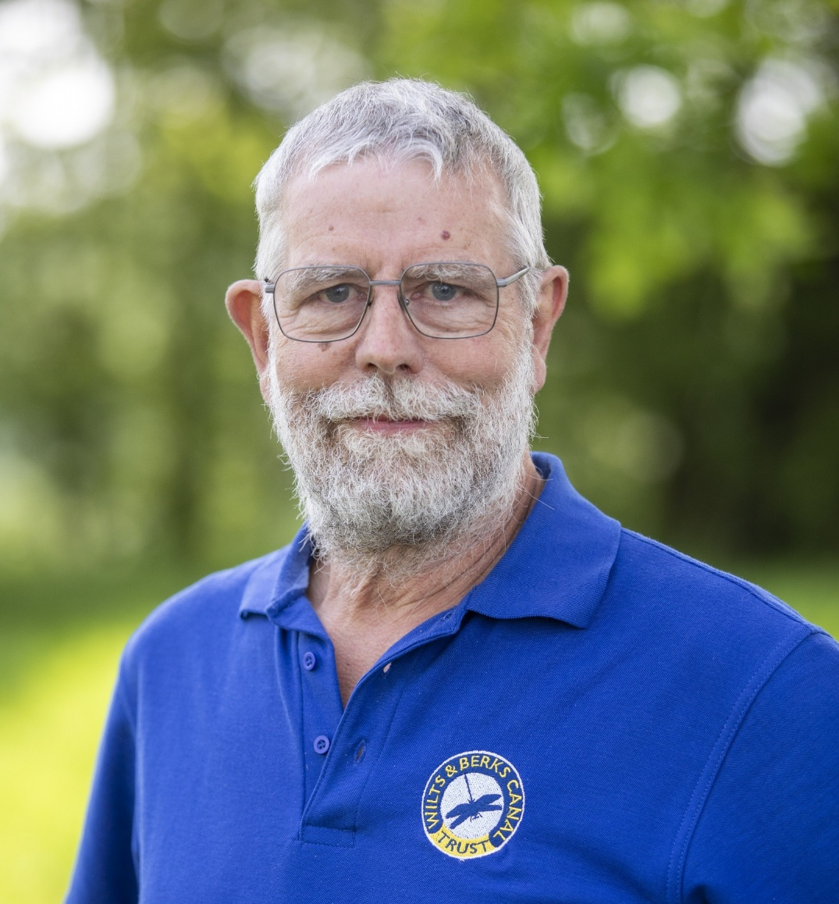
Introduction
“I want to share today a very specific problem facing the Wilts & Berks Canal.
But I don't want this presentation only to be seen as a request for help with our campaign.
What is happening to us raises a much wider question for every canal restoration project in the country.”
Martin Holliss
Chair of the Trustees
Wilts & Berks Canal Trust
28
28
28

Slide 29
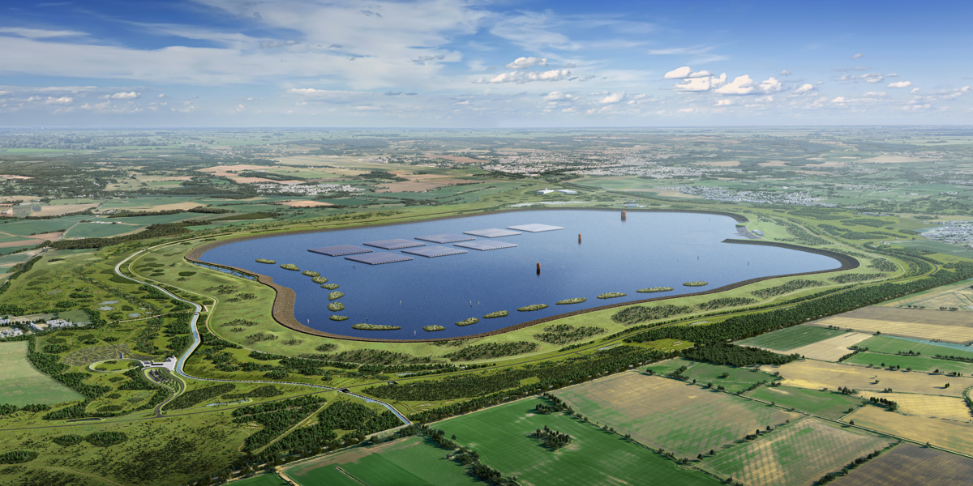
White Horse Reservoir: an existential threat?
Nationally Significant Infrastructure Projects (NSIPs) can have profound consequences for canal restoration
Given the huge benefit canals bring, the planning system does not give them the weight they deserve
WHR poses an existential threat for the Wilts & Berks and is a dangerous precedent for other canal restoration projects
29
29
29

Slide 30
Focus for the next 15 minutes…
What happens to the Wilts & Berks
could matter to all of us
WBCT context
White Horse Reservoir
Canal-related issues
Request for help
30
30
30

Slide 31
Wilts & Berks Canal Trust
70 miles of canal line
  Entire canal line protected in planning policy
  Development along canal line must not prejudice future delivery (physically or financially)
Clear focus onto 4
strategic programmes
Strong support from all
8 MPs and all local Councils

Slide 32
White Horse Reservoir
SW of Abingdon
2nd largest reservoir in England supplying London & Southeast
Would flood historic route of Wilts & Berks canal and 3 restorable locks
32
32

Slide 33
Implication for Wilts & Berks
Thames Water plan to do the minimum canal work possible, loading huge future costs onto WBCT
Poses an existential threat to viability of entire 70 mile Wilts & Berks project
£149m of extra
WHR-related cost

Slide 34
Implication for Wilts & Berks
£149m of extra
WHR-related cost
= +50% on entire £300m project cost
Thames Water plan to do the minimum canal work possible, loading huge future costs onto WBCT
Poses an existential threat to viability of entire 70 mile Wilts & Berks project

Slide 35
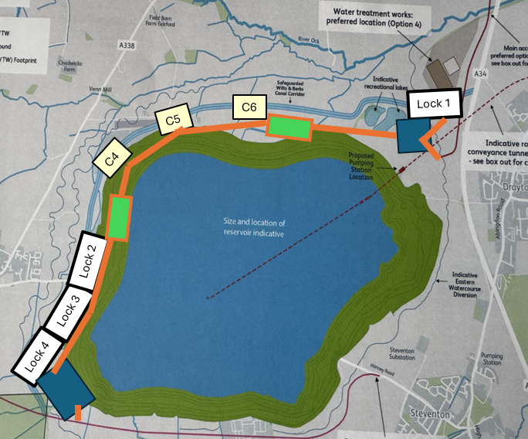
Additional costs imposed on WBCT*…
Excavating and building 4 locks
and temporary access roads after reservoir has been filled
Disposal of Oday Hill excavations
A34 crossing after reservoir and leisure facilities have been opened
Demolition of 3 pedestrian bridges and construction of new bridges all to navigable height
* by current Thames Water reservoir design, if approved
35
35
35

Slide 36
Additional costs imposed on WBCT*…
Excavating and building 4 locks
and temporary access roads
after reservoir has been filled
Much more complex/ expensive
All Reservoir Panel Engineer (ARPE) may refuse lock excavations at toe of operational reservoir, making canal landlocked with no appeal
* by current Thames Water reservoir design, if approved
Credit: Chesterfield Canal Trust
36
36
36

Slide 37
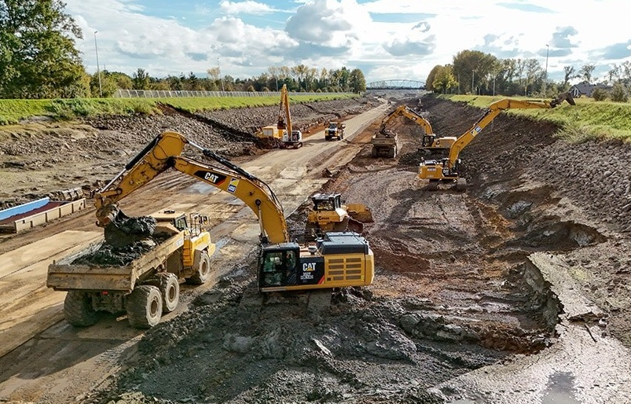
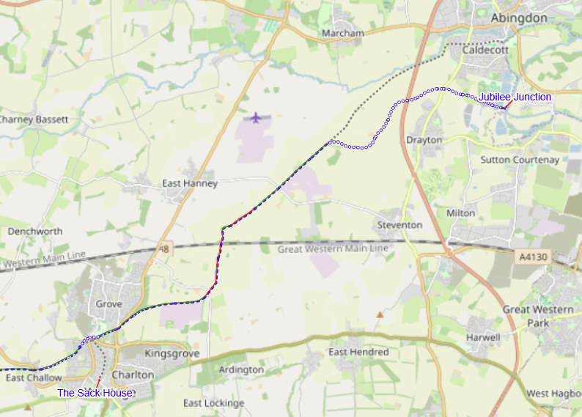
Additional costs imposed on WBCT*…
* by current Thames Water reservoir design, if approved
Disposal of c.400,000 tonnes of Oday Hill excavations
£74m cost
c.30,000 lorry loads on local roads?!
If reservoir is not built, would be transported offroad (under A34) and used for canal embankment
Thames Water plans for 4th lock massively increases excavation
37
37
37

Slide 38
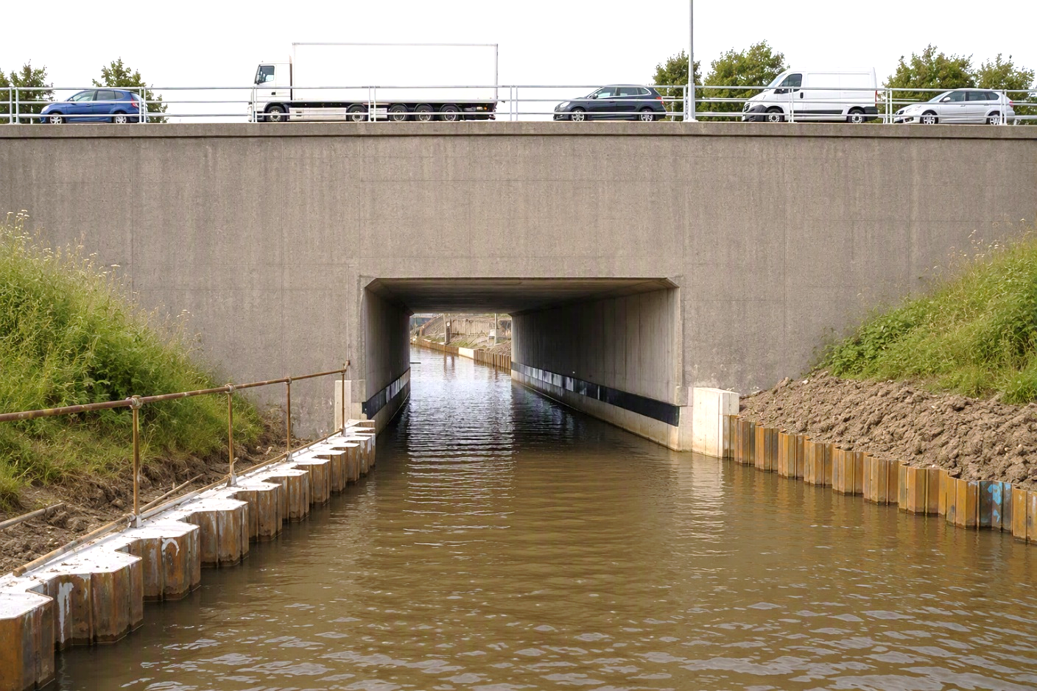
Additional costs imposed on WBCT*…
A34 crossing after reservoir and leisure facilities have been opened
Much more expensive
doing this after the
WHR has been built
More complex A34 diversion, more difficult access, and highly-restricted space due to reservoir, leisure and access infrastructure
* by current Thames Water reservoir design, if approved
38
38
38

Slide 39
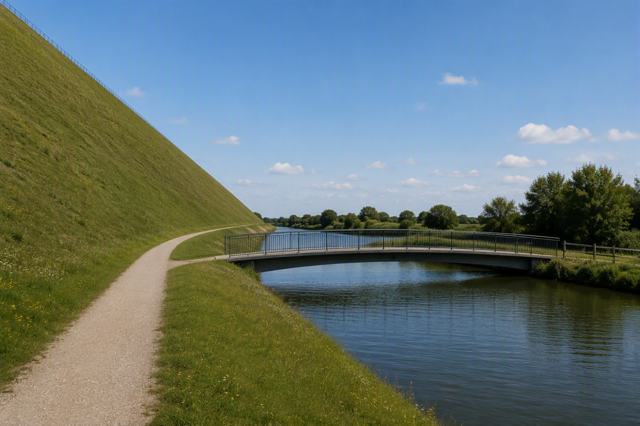
Additional costs imposed on WBCT*…
* by current Thames Water reservoir design, if approved
Demolition of 3 pedestrian bridges and construction of new bridges all to navigable height
Nonsensical and hugely wasteful to build then demolish several bridges
39
39
39

Slide 40
The bottom line…
Thames Water don’t (seem to) care that they’re loading £149m of cost onto WBCT and creating an existential threat

Slide 41
Implication for UK canal restoration
Our canal restoration project could be stopped in its track.
So could others!
If one NSIP is allowed to do this then other canal restoration projects could well be at risk
Canals need to be given higher priority and be viewed as nationally significant infrastructure
IWA, CRT and all canal restoration societies take note!

Slide 42
Our goal-oriented actions…
Active lobbying both before and during the DCO process
Active social media campaign
£100k WHR Fighting Fund launched to engage professional advisers
Regular comms with stakeholders
    MPs
    Thames Water
    Ofwat
    County/District/Parish Councils

Slide 43
Request for reservoir-specific help…
Thames Water have huge teams of advisors
We need to build a larger team of people with DCO expertise – whether paid-for or as volunteers
Do you know anybody who can help?
  Ecologists
Planners
Engineers
Waterways
Lawyers
43
43
43

Slide 44

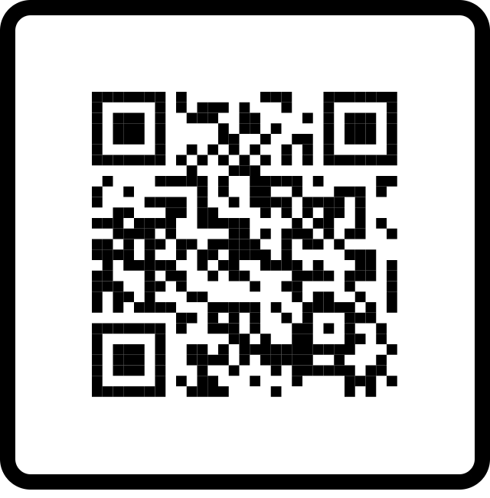
Other ways you can help…
£
Make a
donation
Write to
your MP
Write a Letter
of Support
Brief the
media
Mobilise your
members
WHR Fighting Fund
Ask for canal-related support
for the DCO and for NSIPs
Canal restoration
solidarity!
Local, national,
press, TV or radio
Amplify publicity message; find people with DCO-expertise
Need more detailed briefing?
martin.holliss@wbct.org.uk
Visit our WHR webpage:
www.wbct.org.uk/protect-the-canal
wbct.org.uk/
protect-the-canal
44
44
44

Slide 45
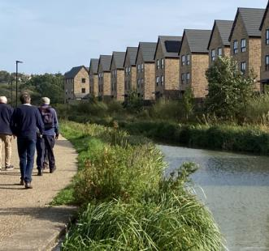
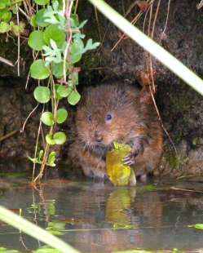
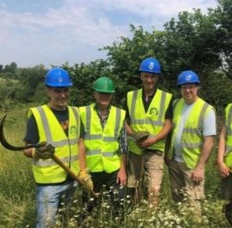
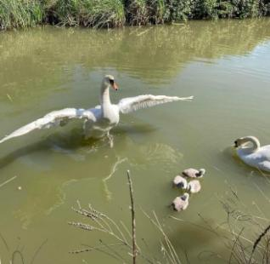
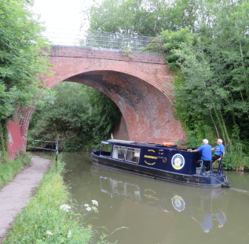
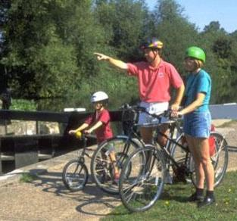
For more information…
Please contact:
Martin Holliss
Chair of the Trustees
Wilts & Berks Canal Trust
Martin.Holliss@wbct.org.uk / 07931 376501
www.wbct.org.uk/protect-the-canal / www.wbct.org.uk/white-horse-action

Slide 46
Talk on the Stafford Riverway Link
Geoff Dobbs

Slide 47
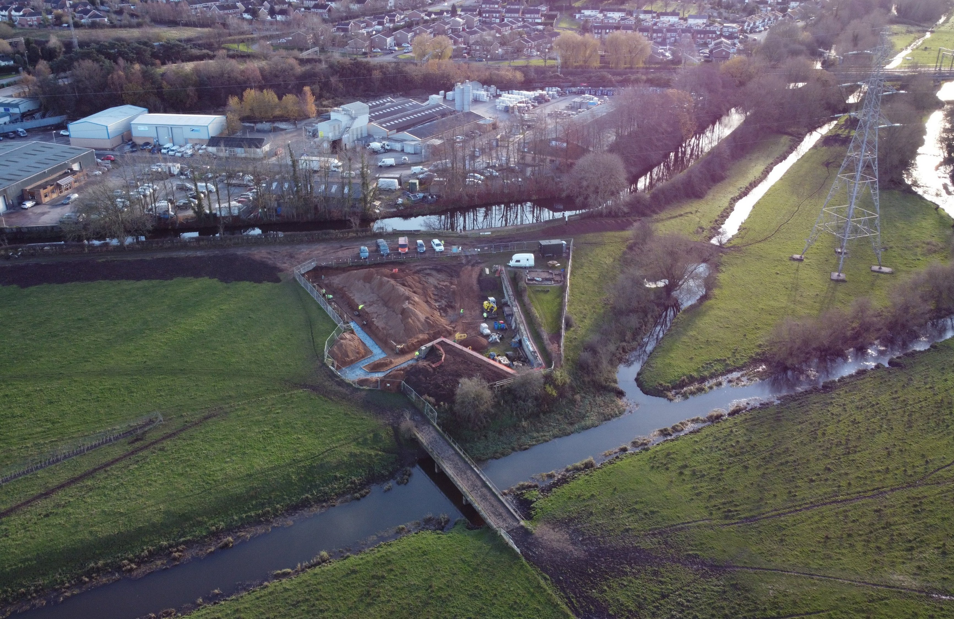

Slide 48
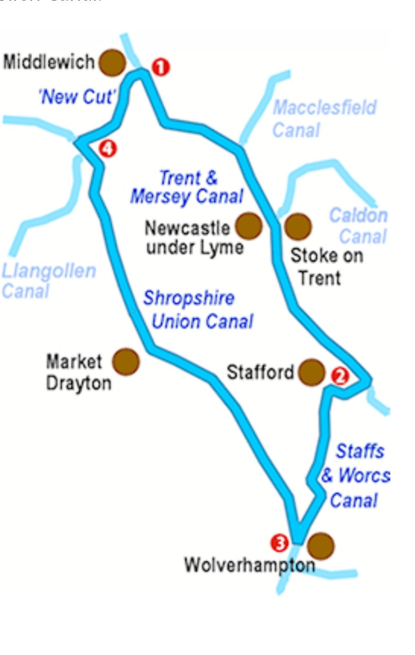

Slide 49
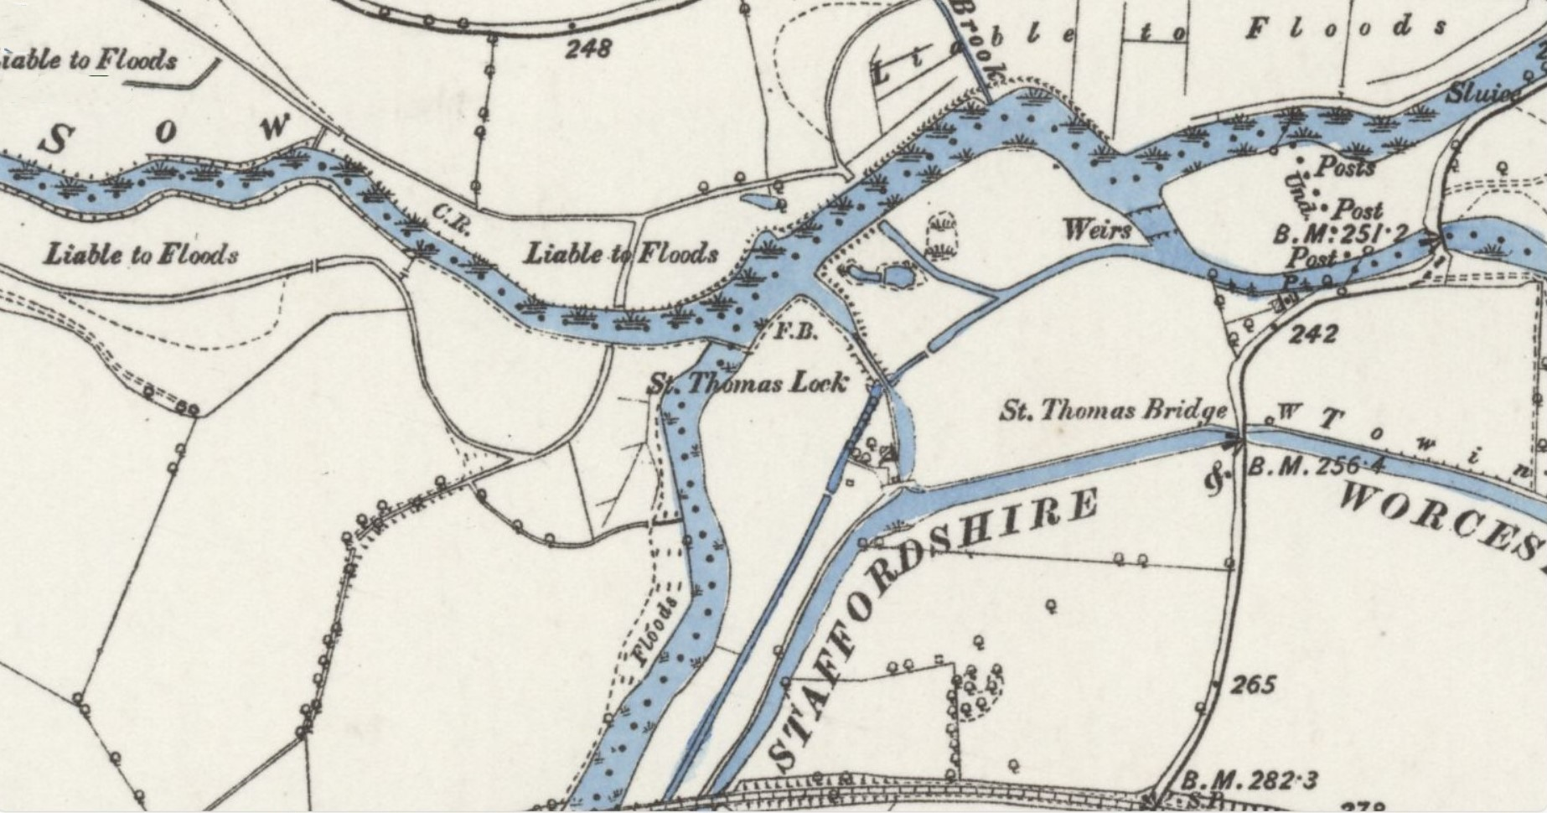

Slide 50
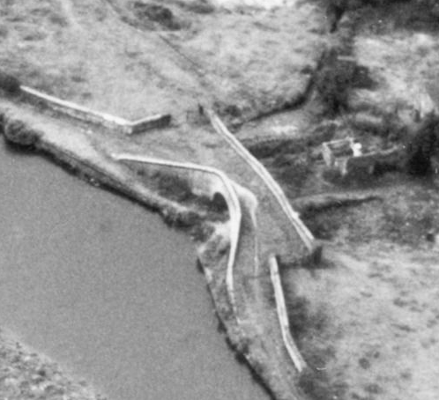
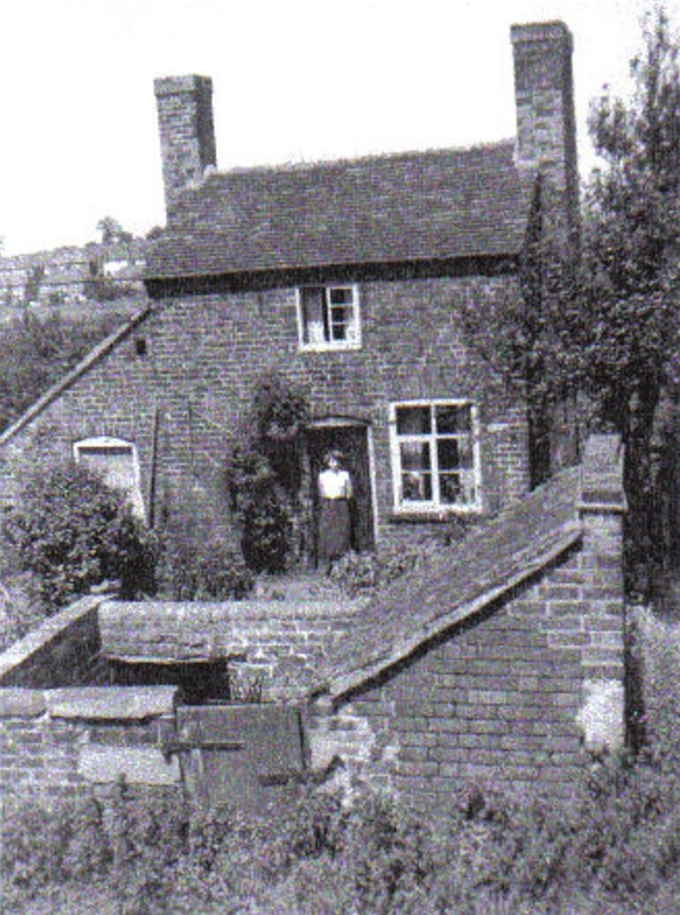

Slide 51
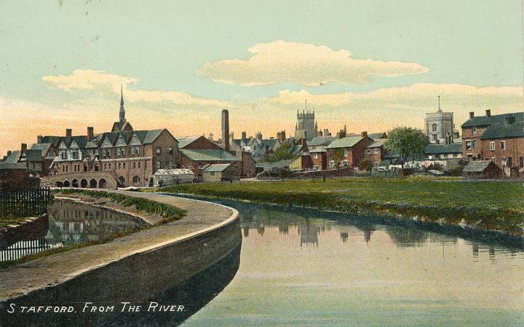
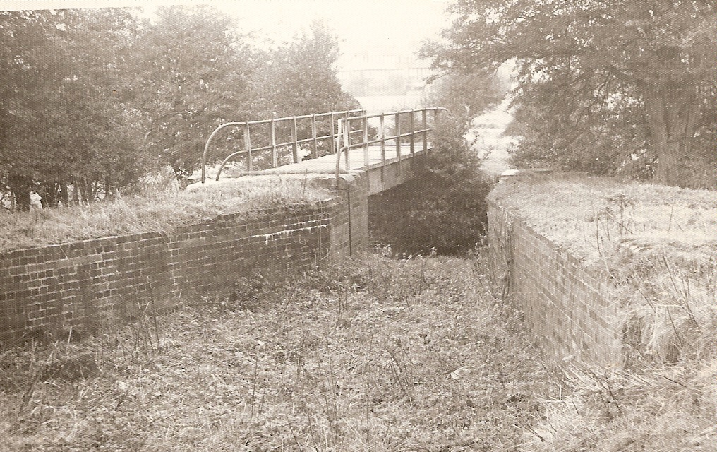

Slide 52
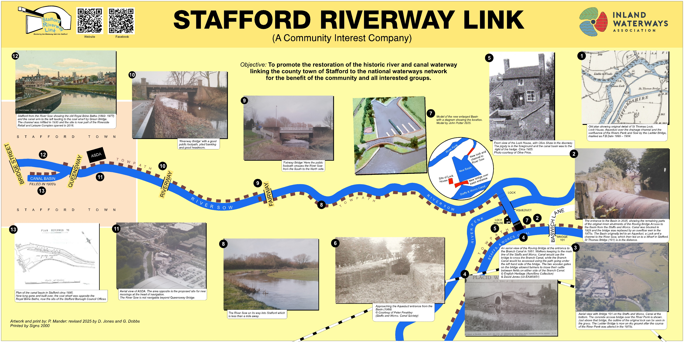

Slide 53
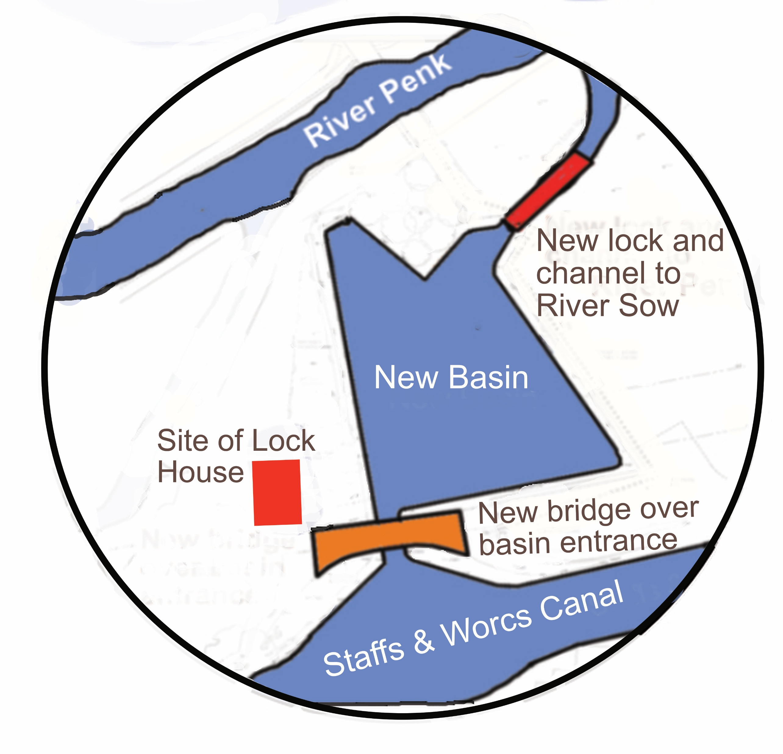
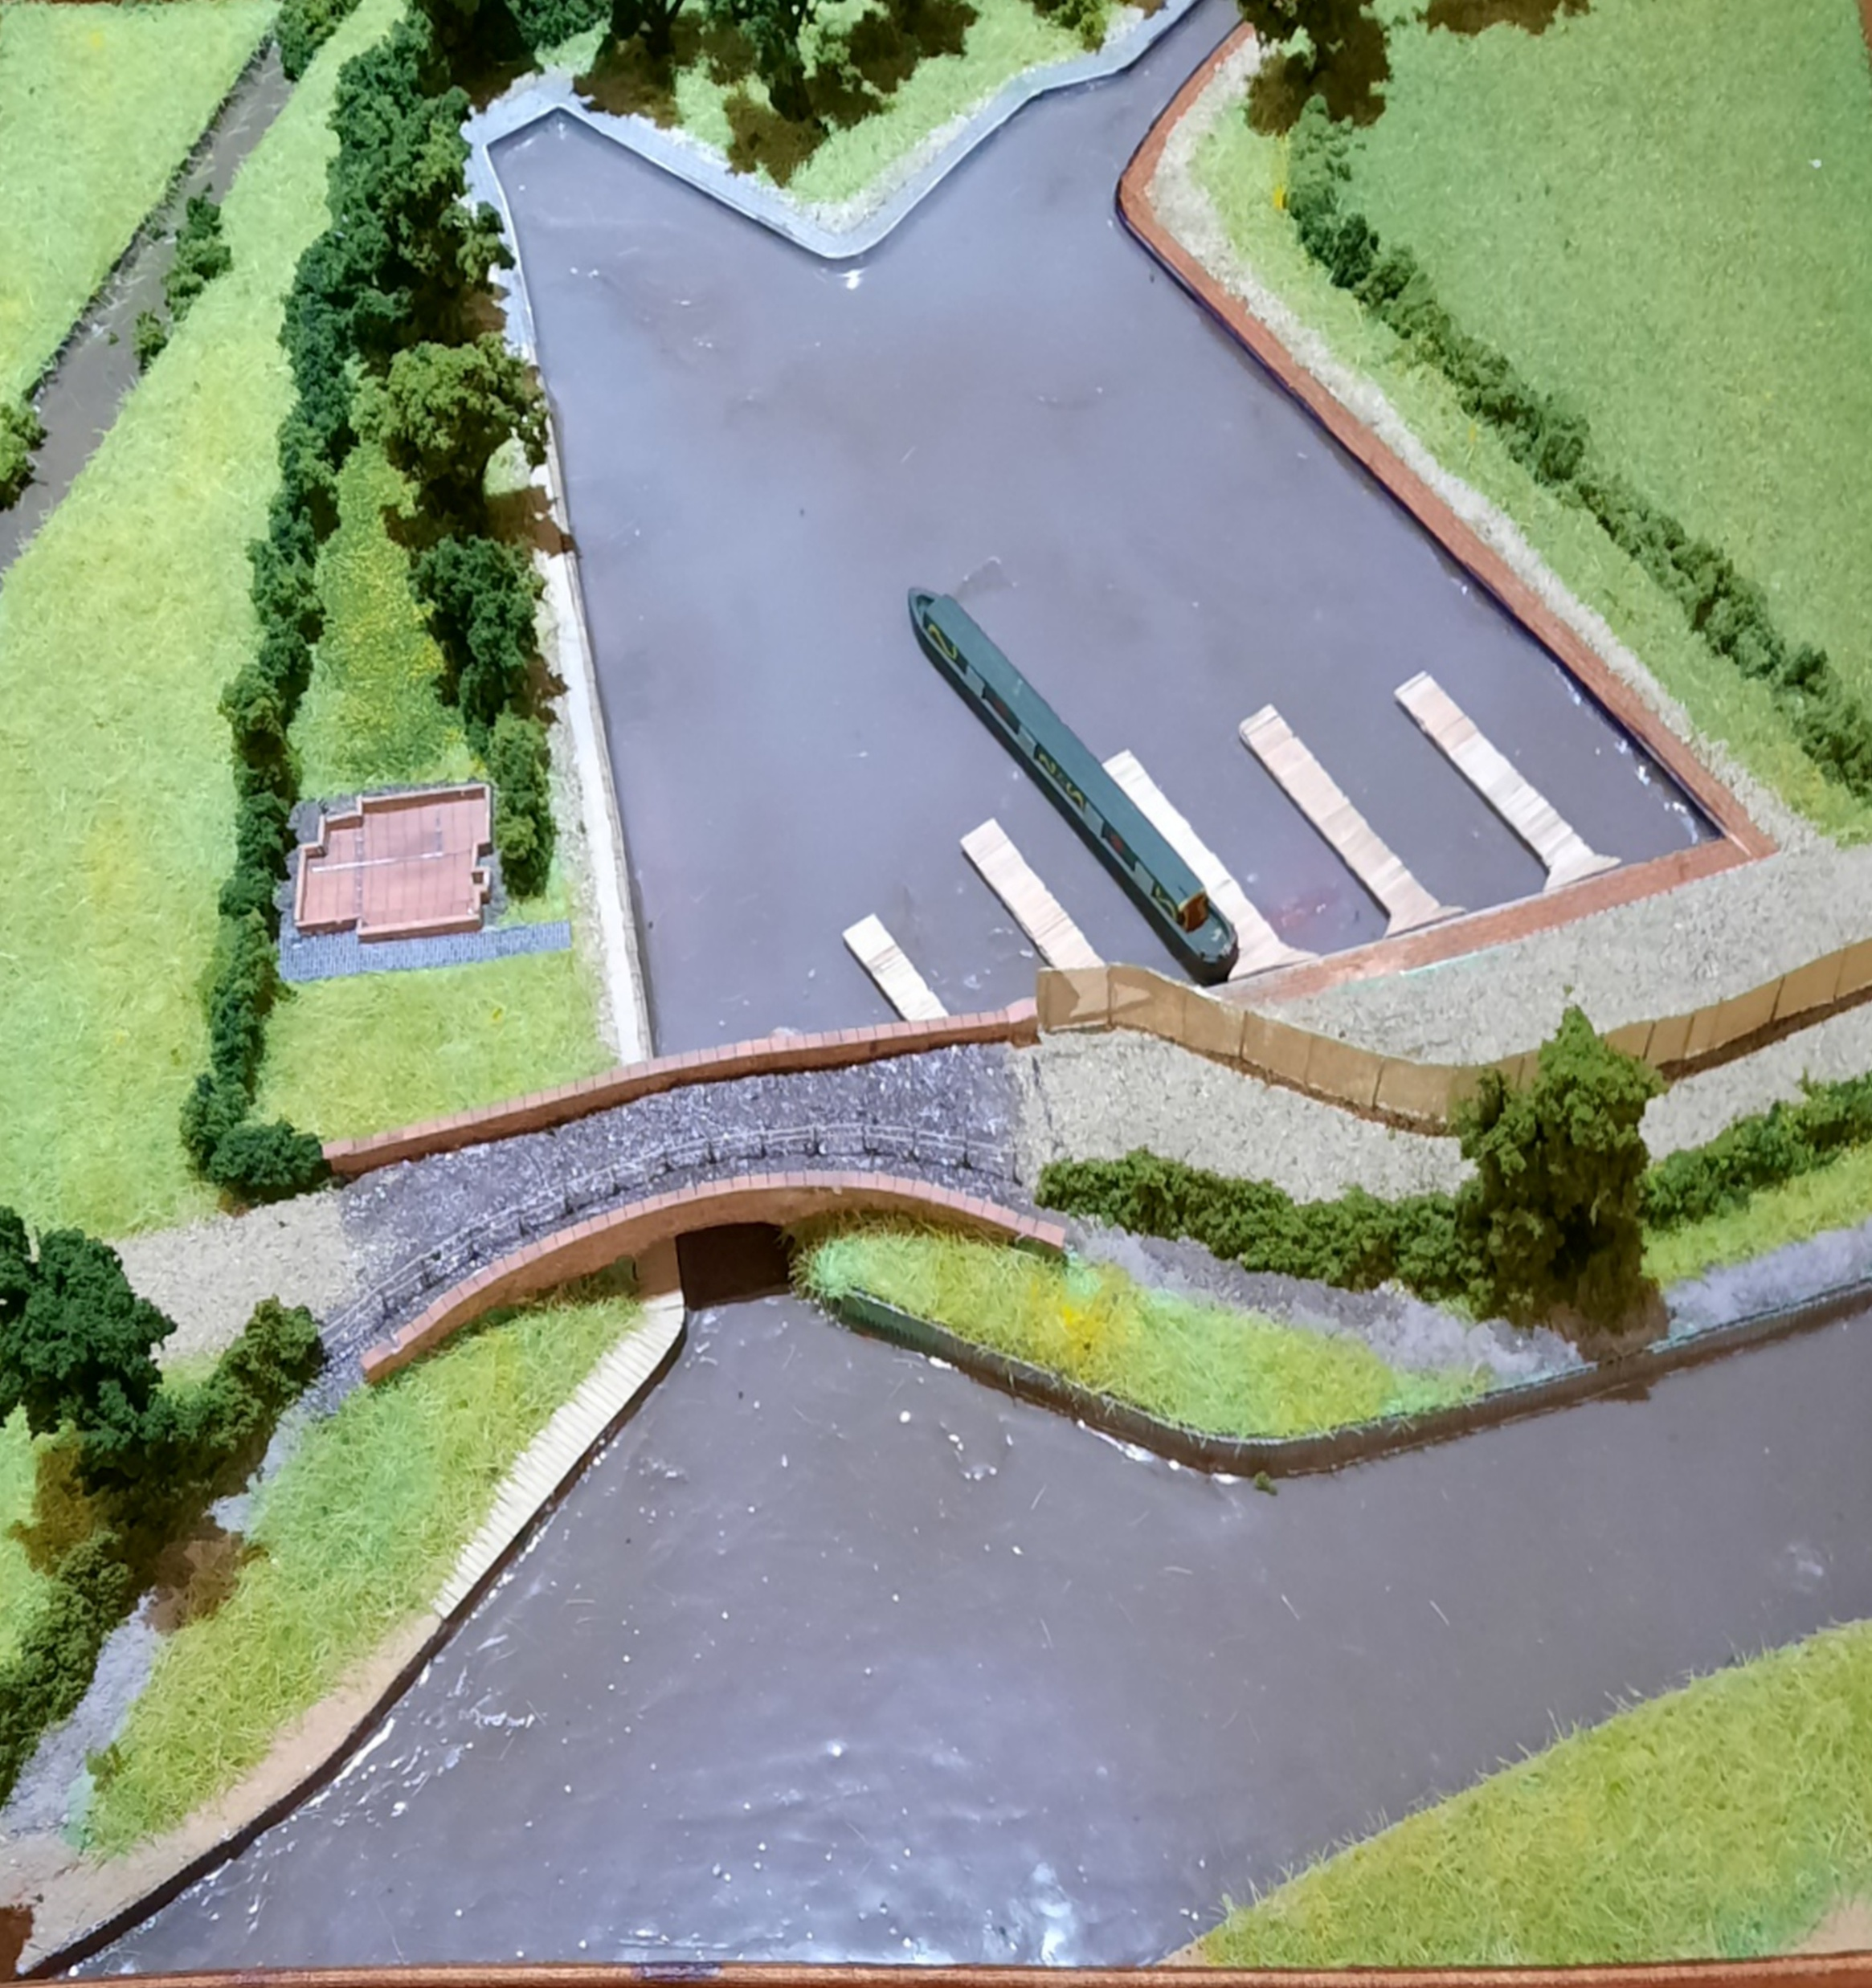

Slide 54
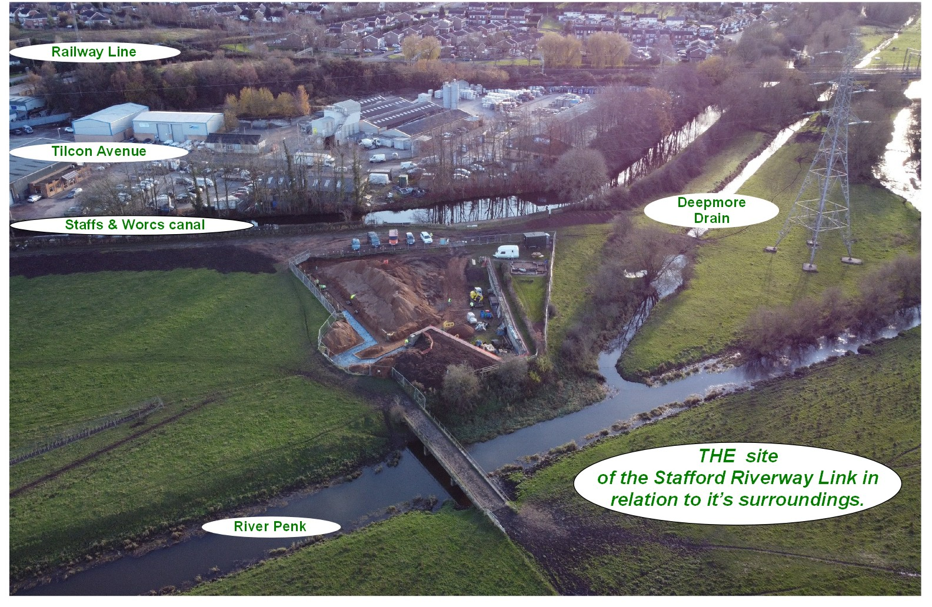

Slide 55
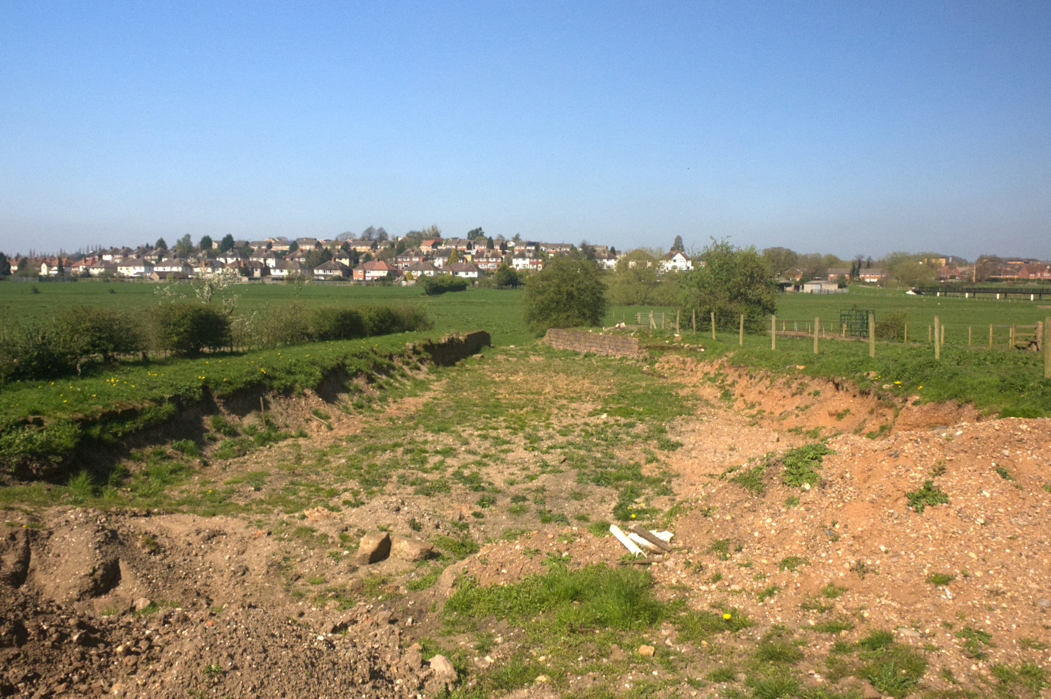
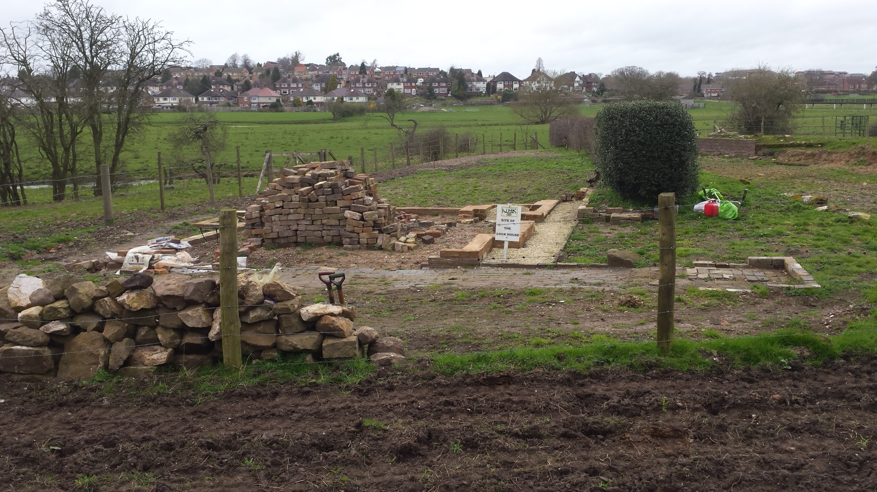

Slide 56
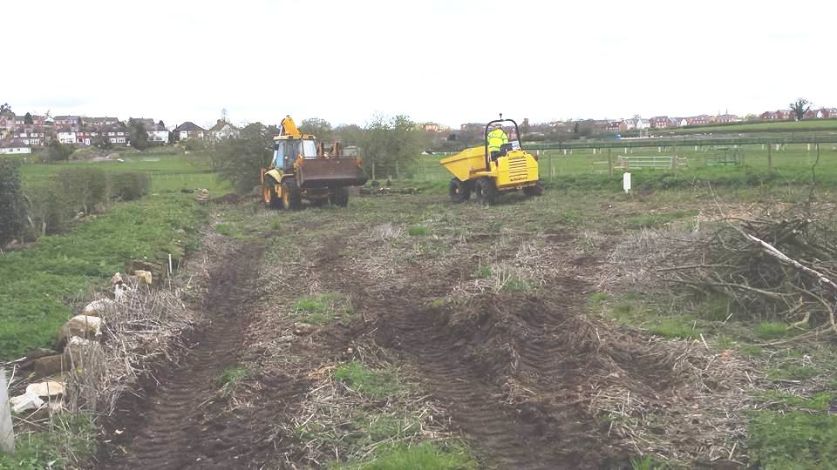
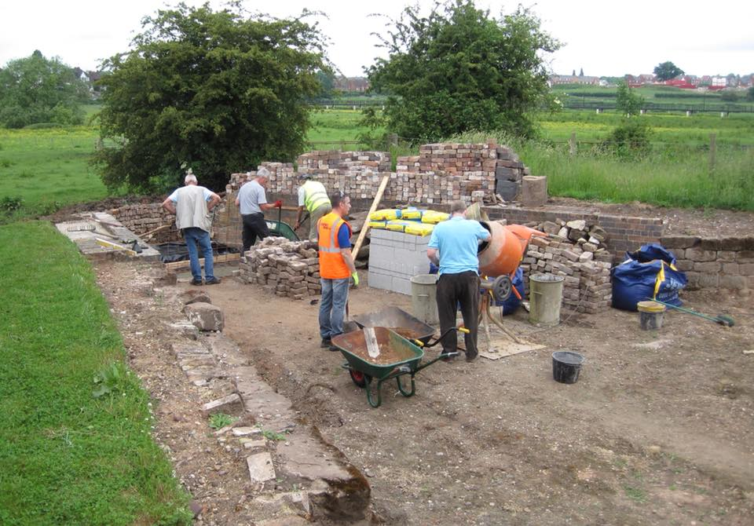

Slide 57
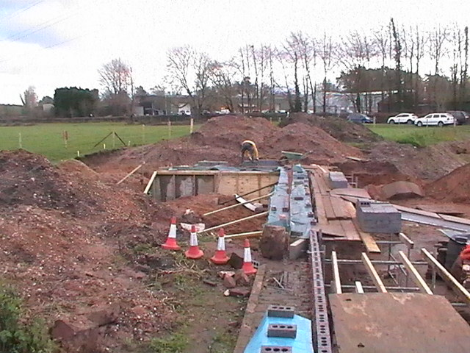
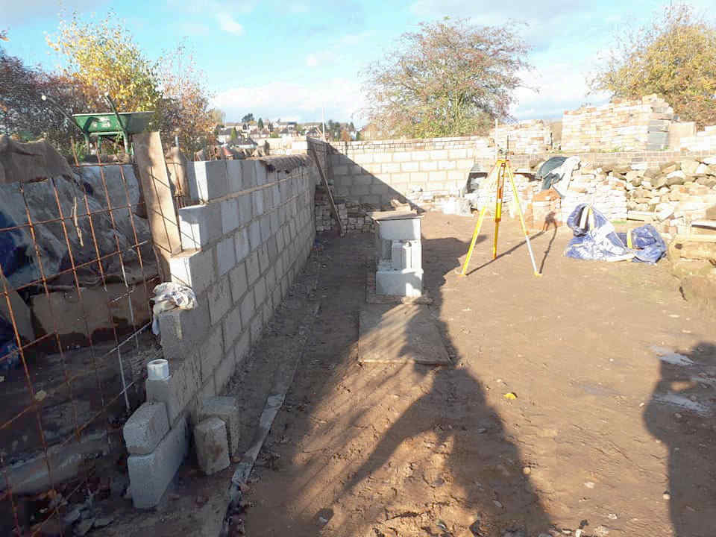

Slide 58
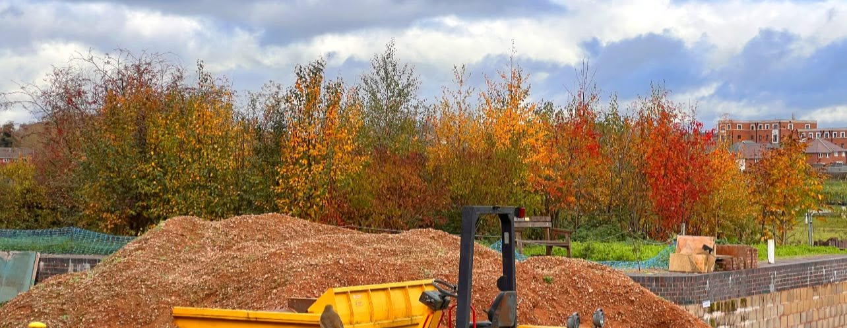
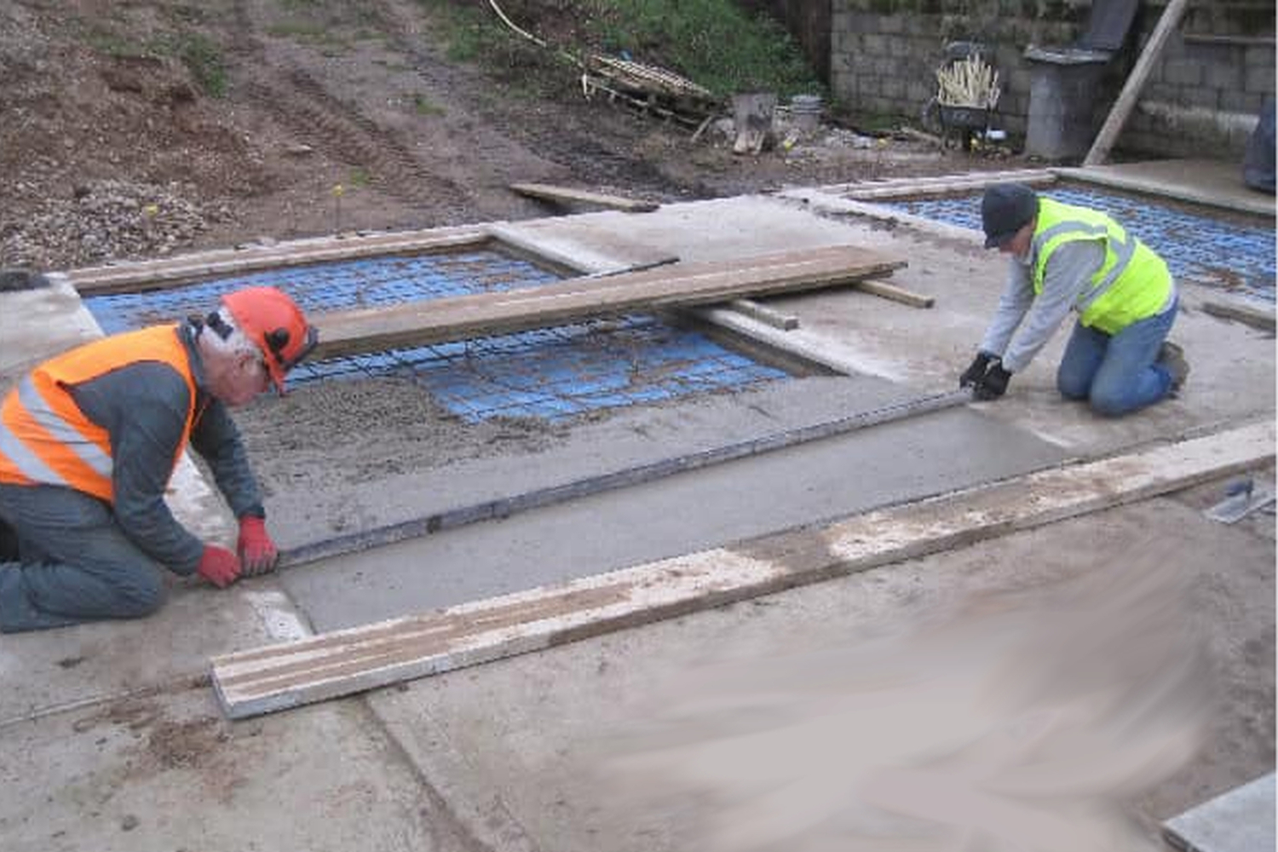
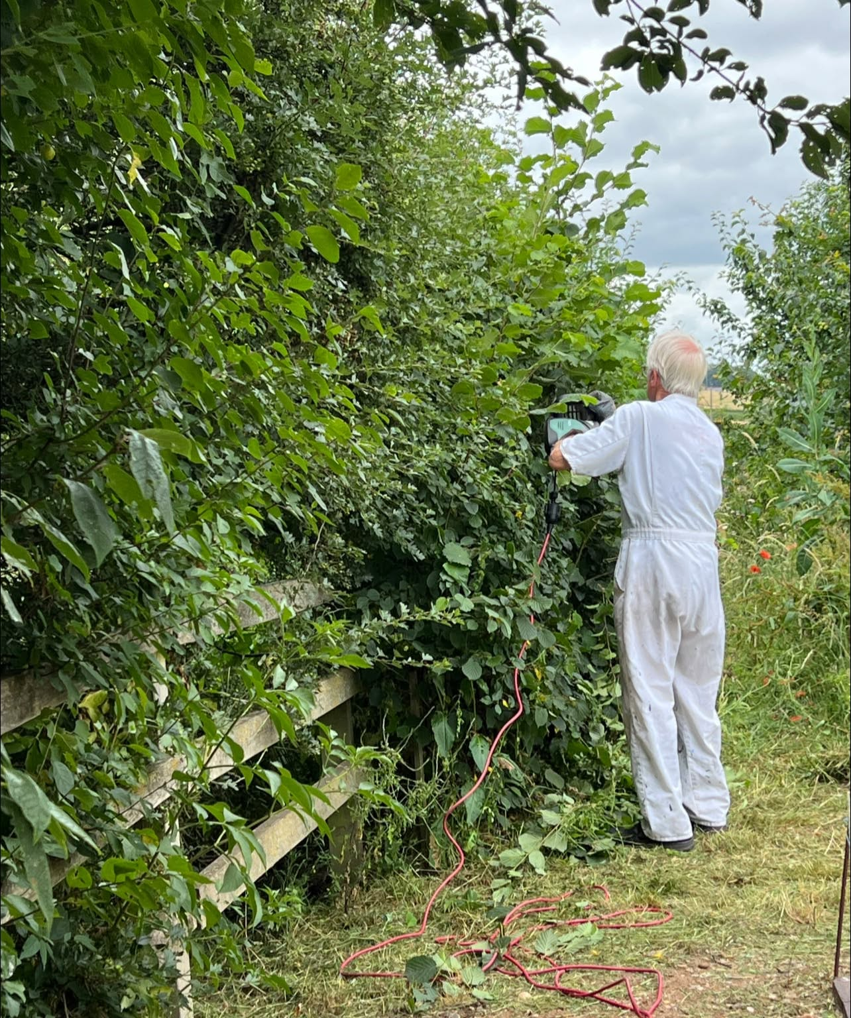

Slide 59
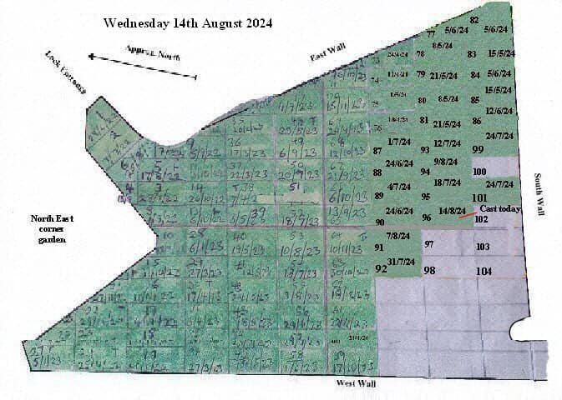
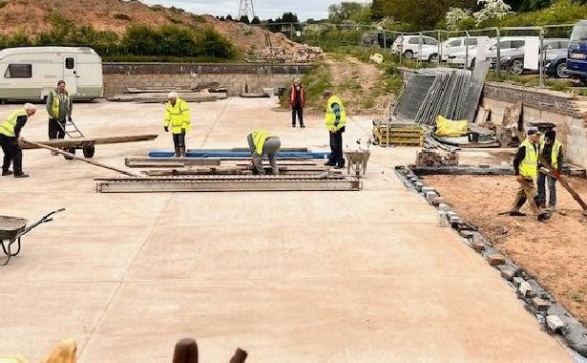

Slide 60
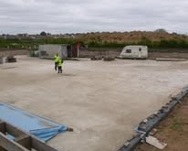
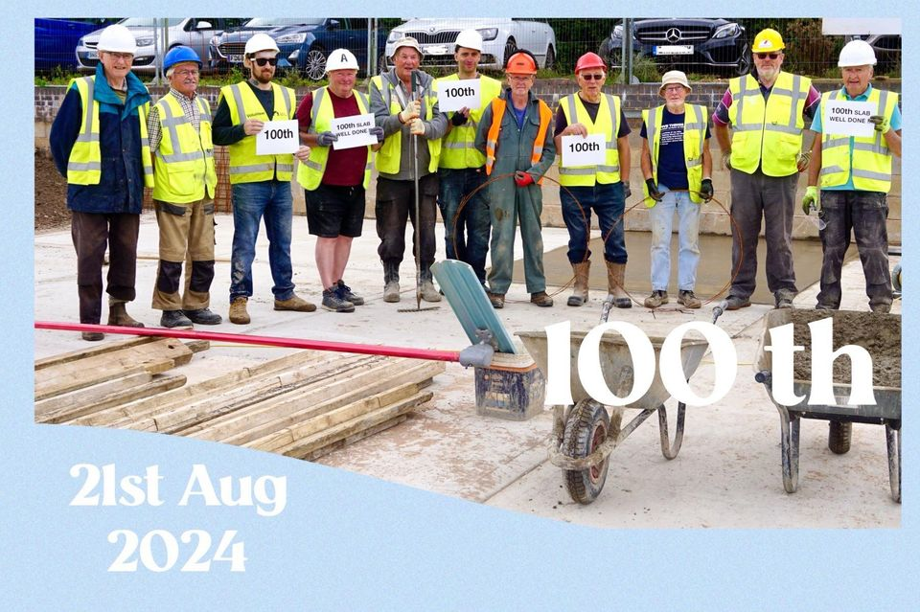

Slide 61
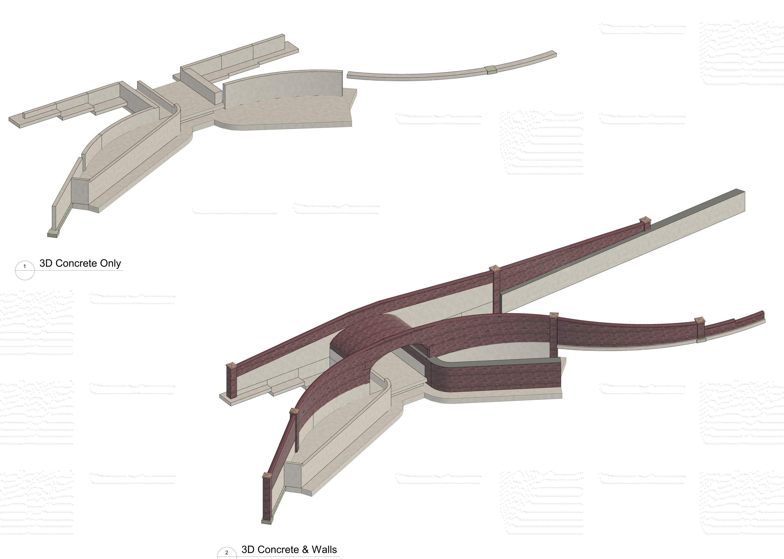
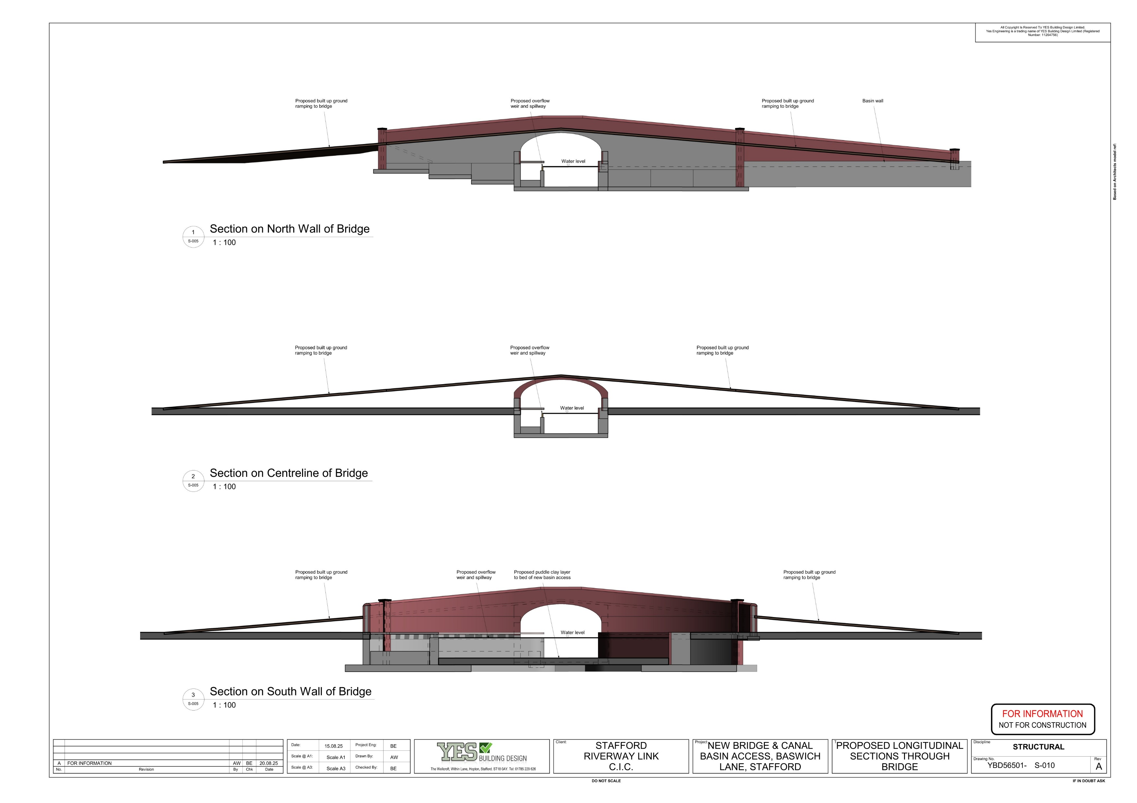

Slide 62
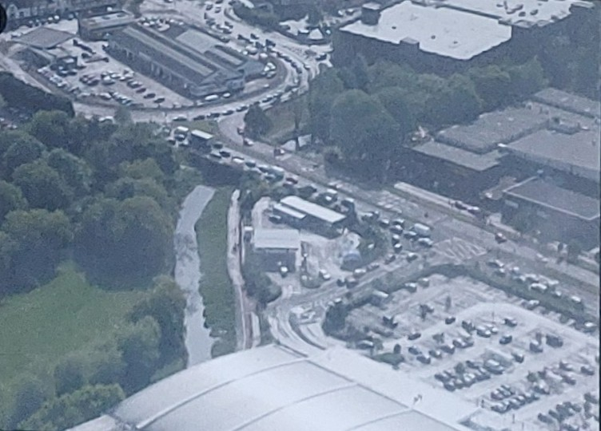

Slide 63
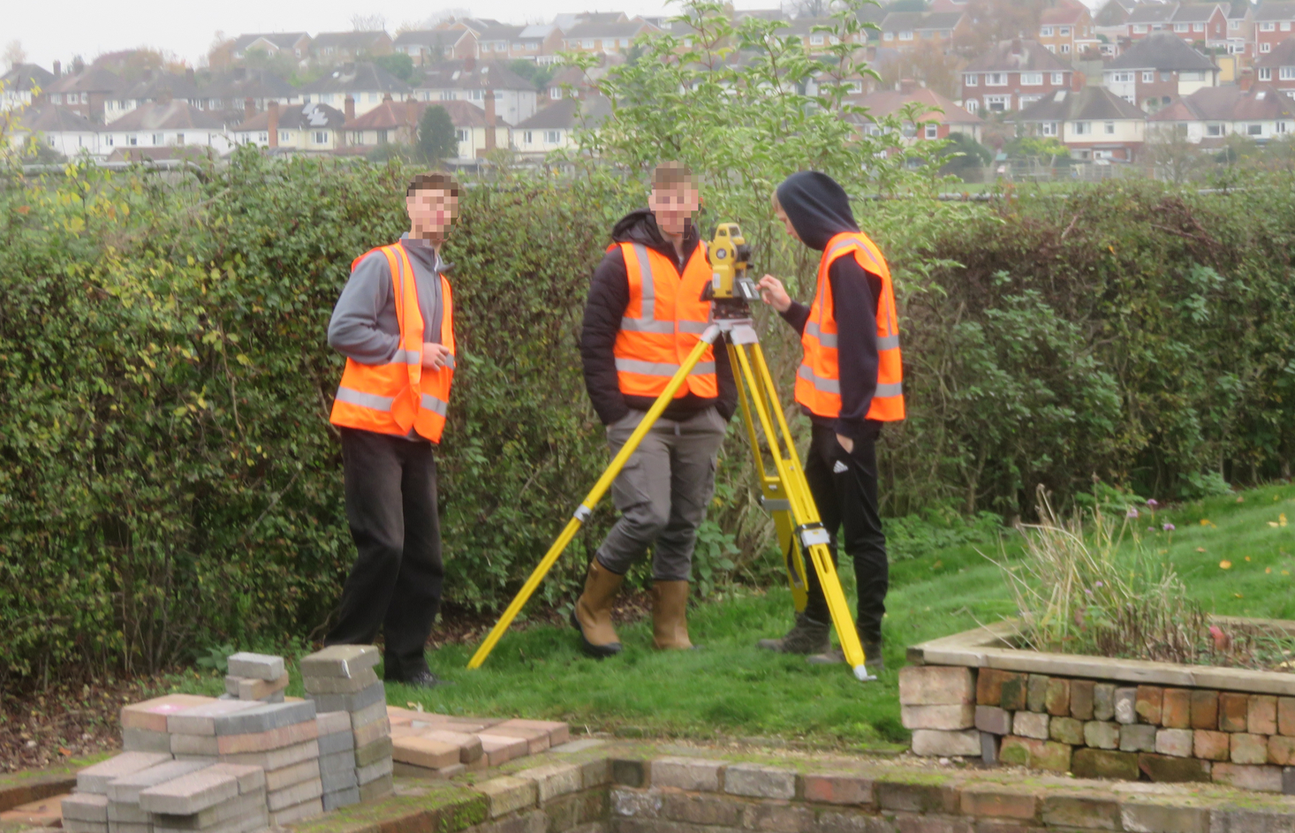
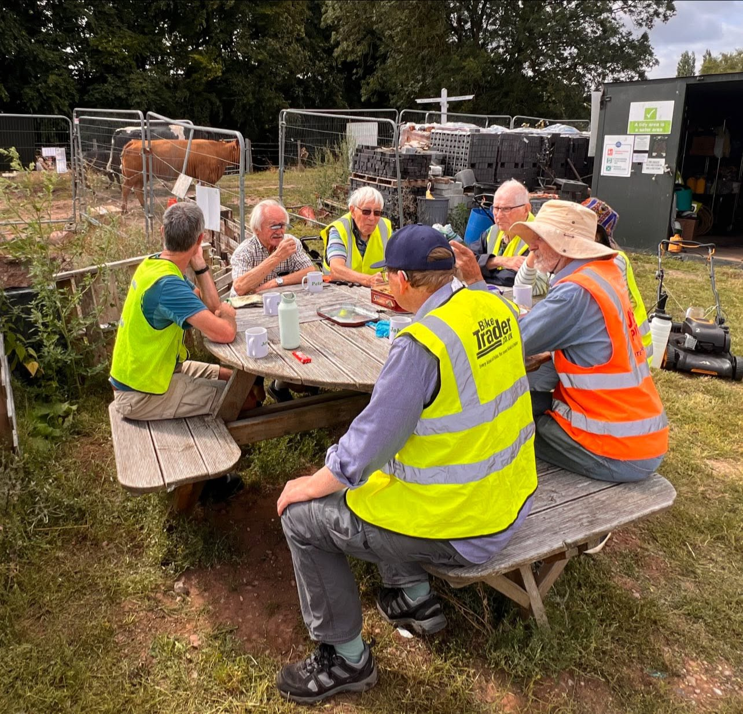

Slide 64
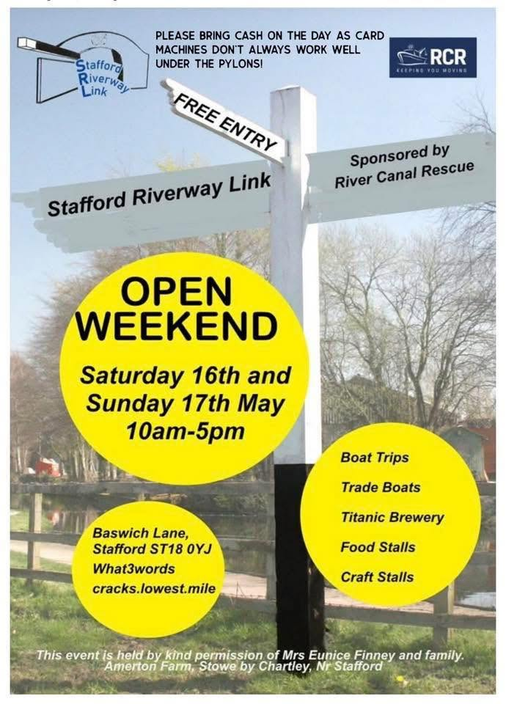
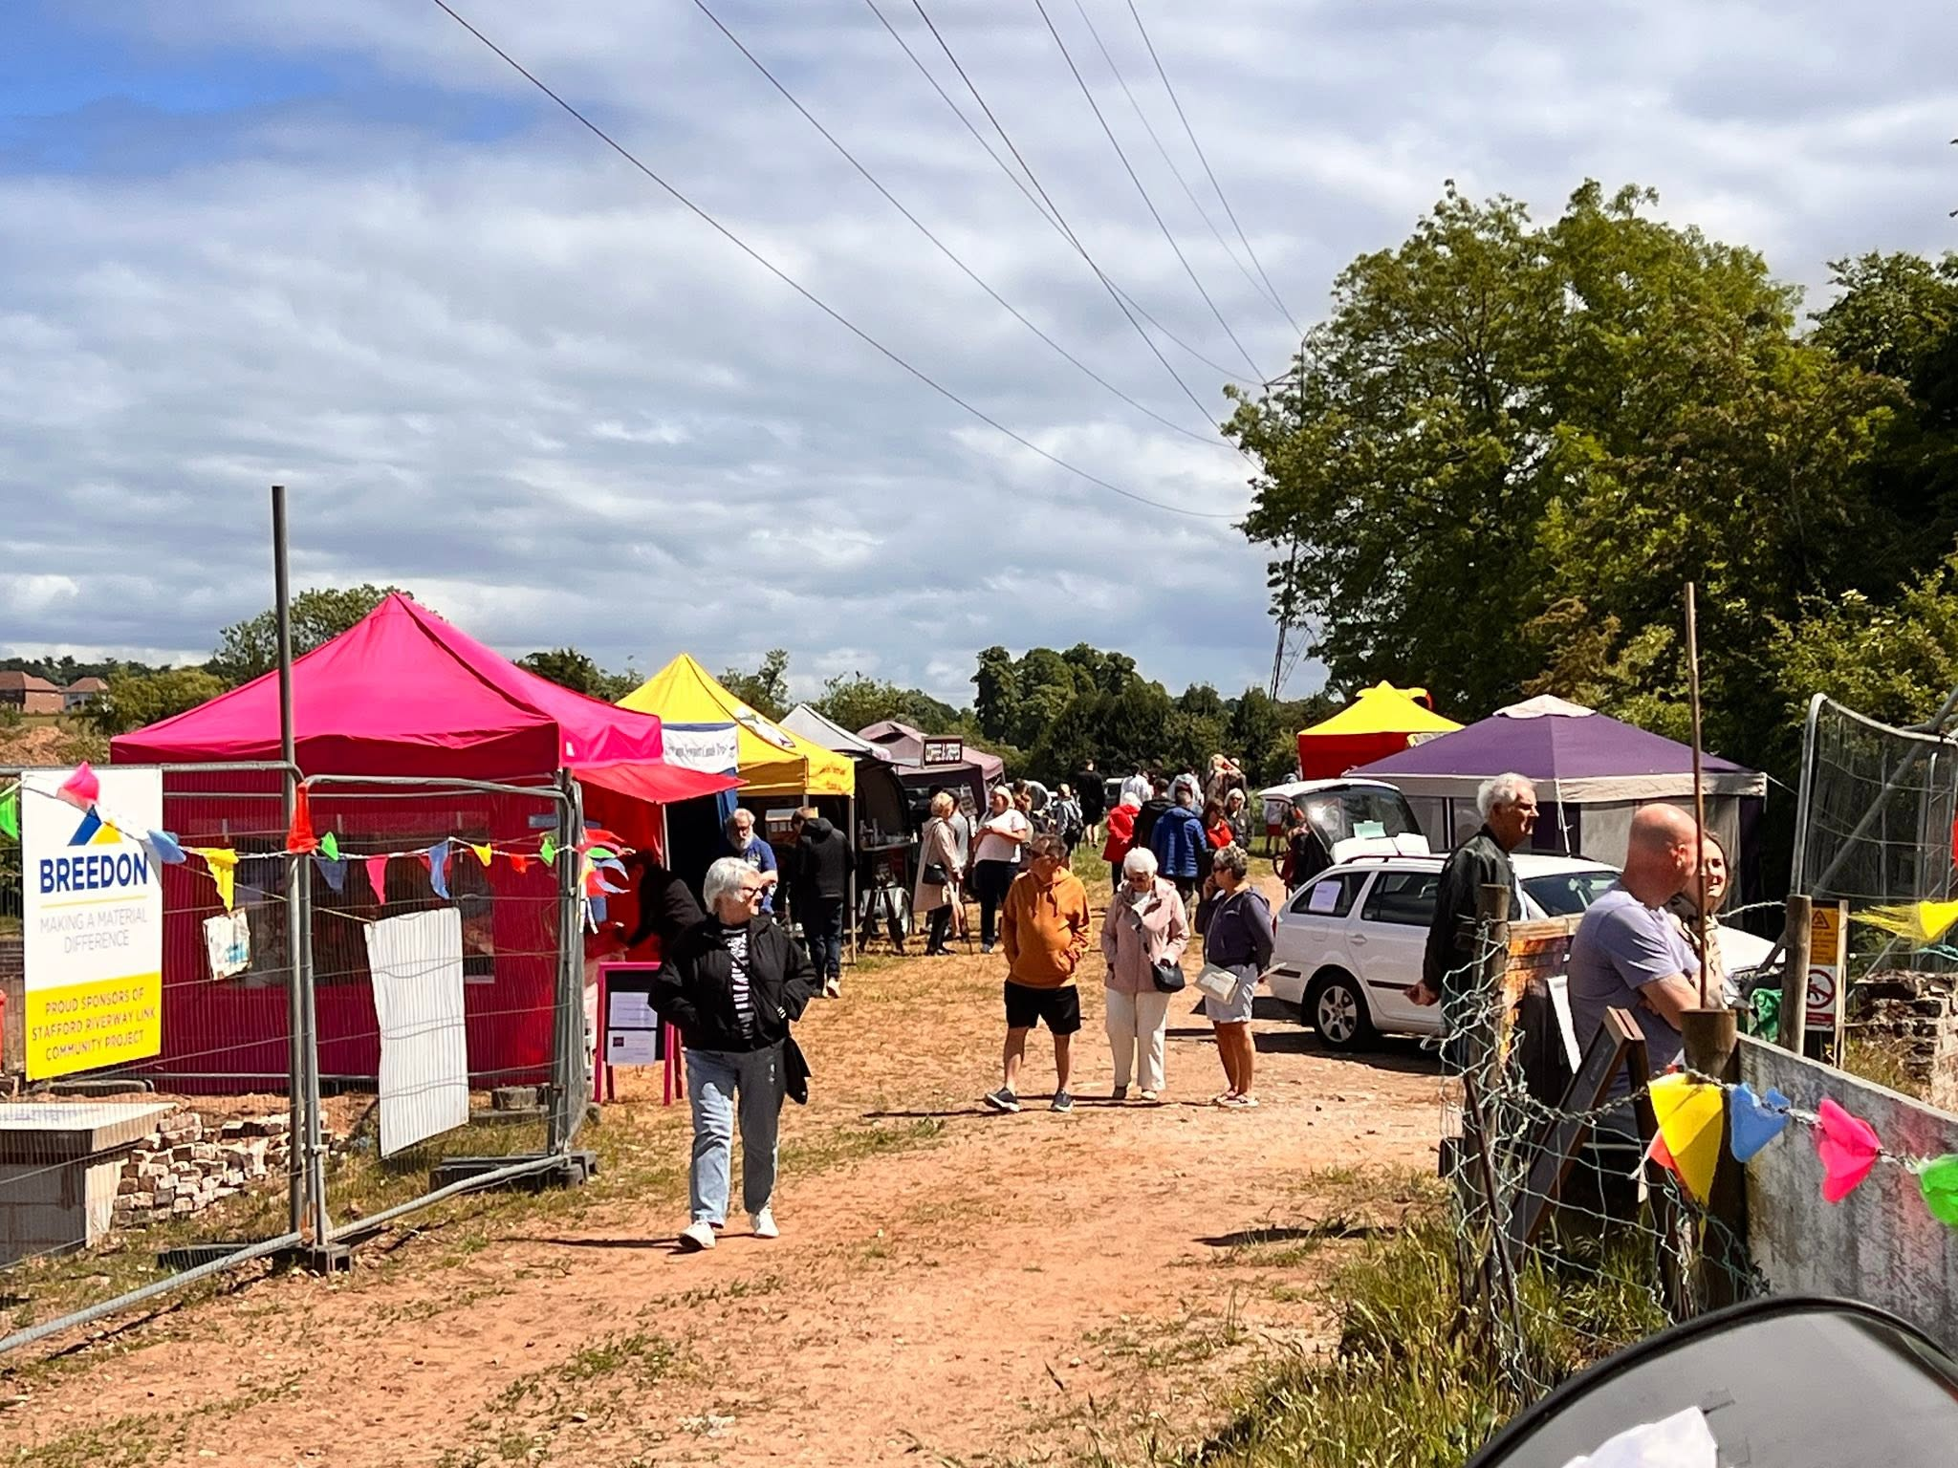

Slide 65
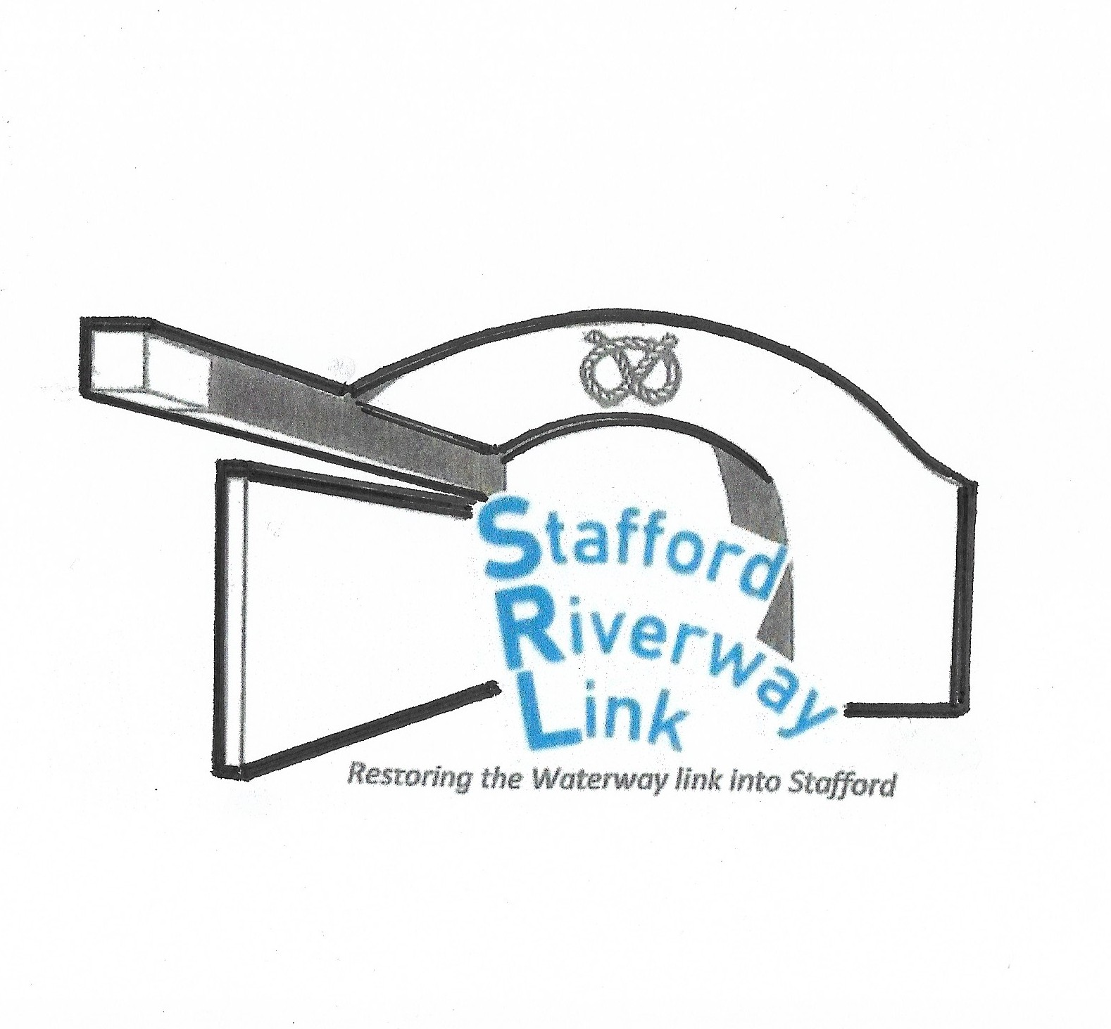


Slide 66
Future Presentations

Slide 67
Lunch

Slide 68
TheNorthern Canals Association meetings
Andy Keane

Slide 69
background
In 1978, Robert Higgs founded the Southern Canals Association, followed by Keith Gibson’s Northern Canals Association in 1991.
The SCA folded during the late 2010’s due to low attendances.
The NCA stopped holding meetings in 2018 but restarted following COVID in 2022.
The NCA currently holds two meetings per year dovetailed around the annual Restoration conference. It has organised 87 site visits to date.

Slide 70
NCA forward programme
Date | Host Society / Organisation
4 October 2026 | Avon Navigation Trust
21 March 2027 | Wilts and Berks Canal Society
10 October 2027 | Sankey Canal Restoration Society (their 4th hosting)
26 March 2028 | Buckingham Canal Society
October 2028 | Hereford & Gloucester - To be confirmed

Slide 71
NCA recommendations
The NCA’s meeting format should continue broadly as it is: locally driven by host societies and designed to dovetail with the Restoration Conferences.
The Restoration Conferences should return to the Wolverhampton model, focusing on the national issues of the day through a centralised venue, longer programme, national speakers and seminars.
The NCA should continue to provide an independent forum for open email discussion between organisations.
The NCA should maintain its link between the Weeping Cross fund and local groups.

Slide 72
How can IWA support restoration groups with CDM compliance?
George Rogers

Slide 73
KEY QUESTIONS from briefing note
The Restoration Panel members are therefore asked to consider the following:
How well do you think your restoration group, and you individually, understand the CDM regulations and your responsibilities under them?
For your current projects, have you appointed the necessary dutyholders? If so, who have you appointed, and how have you assessed they are competent for the role?
Would your current dutyholders meet the CRT requirements?
Are you aware of / have you used any of the guidance produced by IWA on CDM?
How could IWA support your group, and you individually, in regard of CDM?
Note, whilst the competency requirements noted in the briefing note are specifically for CRT, the questions above apply universally to all restoration groups.

Slide 74
Future “Topics of Interest Talks”

Slide 75
Brief review of day, date and possible location of next meeting

Slide 76
Any Other Business

